Slide 1
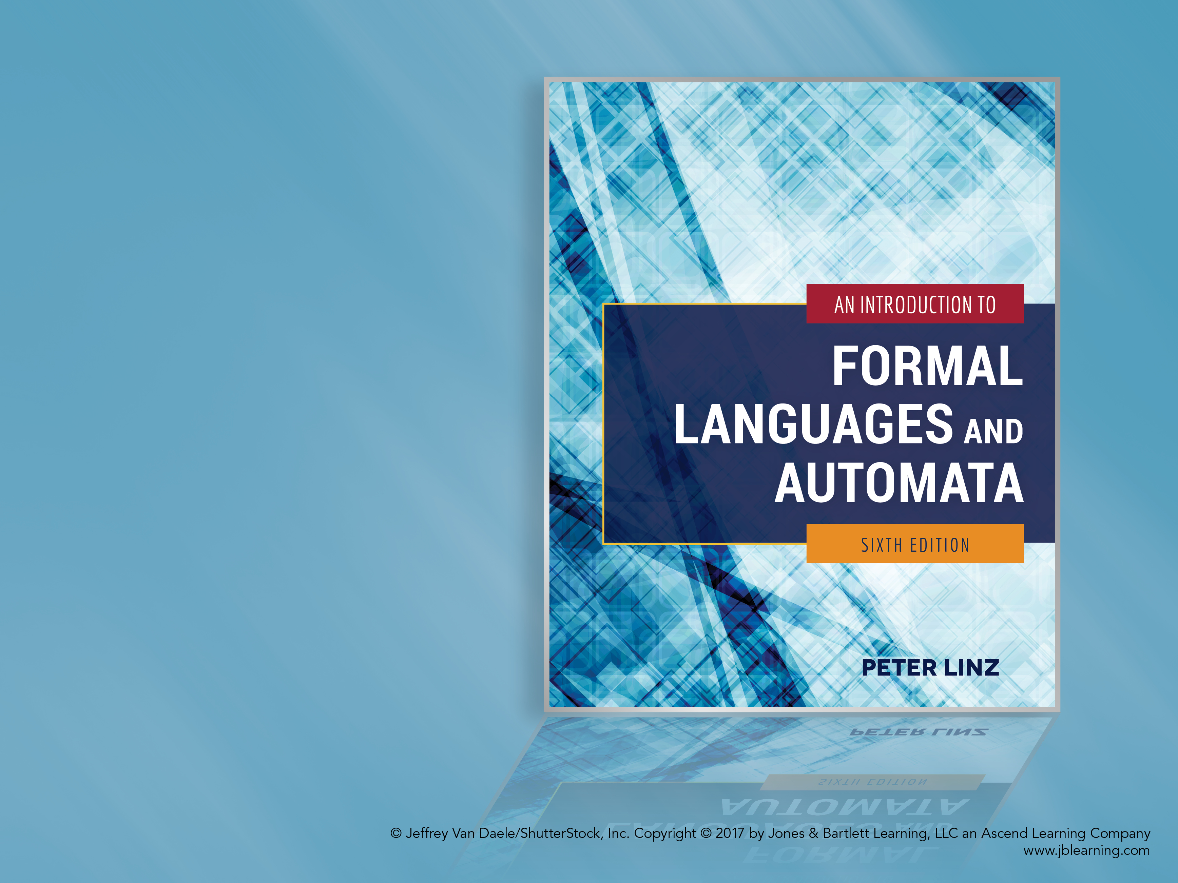
Chapter 8
PROPERTIES OF CONTEXT-FREE LANGUAGES

Slide 2

Learning Objectives At the conclusion of the chapter, the student will be able to:
Apply the pumping lemma to show that a language is not context-free
State the closure properties applicable to context-free languages
Prove that context-free languages are closed under union, concatenation, and star-closure
Prove that context-free languages are not closed under either intersection or complementation
Describe a membership algorithm for context-free languages
Describe an algorithm to determine if a context-free language is empty
Describe an algorithm to determine if a context-free language is infinite

Slide 3
A Pumping Lemma for Context-Free Languages
Theorem 8.1: Given an infinite context-free language L, every sufficiently long string w in L can be broken into four parts uvxyz such that
|vy| ≥ 1
|vxy| ≤ m (where m is an arbitrary integer ≤ |w|)
An arbitrary, but equal number of repetitions of v and y yields another string in L
The “pumped” string consists of two separate parts (v and y) and can occur anywhere in the string
The pumping lemma can be used to show that, by contradiction, a certain language is not context-free

Slide 4
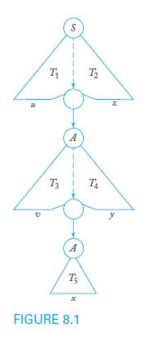
An Illustration of the Pumping Lemma for Context-Free Languages
As shown in Figure 8.1, the pumping lemma for context-free languages can be illustrated by sketching a general derivation tree that shows a decomposition of the string into the required components

Slide 5
Closure Properties for Context-Free Languages
Theorem 8.3 states that if L₁ and L₂ are context-free languages, so are the languages that result from the following operations:
L₁ ∪ L₂
L₁ ∩ L₂
L₁*
In other words, the family of regular languages is closed under union, intersection, and star-closure.
To prove these properties, we assume the existence of two context-free grammars G₁ and G₂ that generate the respective languages

Slide 6
Proof of Closure under Union
Assume that L₁ and L₂ are generated by the context-free grammars G₁ = (V₁, T₁, S₁, P₁) and G₂ = (V₂, T₂, S₂, P₂)
Without loss of generality, assume that the sets V₁ and V₂ are disjoint
Create a new variable S₃ which is not in V₁ ∪ V₂
Construct a new grammar G₃ = (V₃, T₃, S₃, P₃) so that
V₃ = V₁ ∪ V₂ ∪ { S₃ }
T₃ = T₁ ∪ T₂
P₃ = P₁ ∪ P₂
Add to P₃ a production that allows the new start symbol to derive either of the start symbols for L₁ and L₂
S₃ → S₁ | S₂
Clearly, G₃ is context-free and generates the union of L₁ and L₂ , thus completing the proof

Slide 7
Proof of Closure under Concatenation
Assume that L₁ and L₂ are generated by the context-free grammars G₁ = (V₁, T₁, S₁, P₁) and G₂ = (V₂, T₂, S₂, P₂)
Without loss of generality, assume that the sets V₁ and V₂ are disjoint
Create a new variable S₄ which is not in V₁ ∪ V₂
Construct a new grammar G₄ = (V₄, T₄, S₄, P₄) so that
V₄ = V₁ ∪ V₂ ∪ { S₄ }
T₄ = T₁ ∪ T₂
P₄ = P₁ ∪ P₂
Add to P₄ a production that allows the new start symbol to derive the concatenation of the start symbols for L₁ and L₂
S₄ → S₁S₂
Clearly, G₄ is context-free and generates the concatenation of L₁ and L₂ , thus completing the proof

Slide 8
Proof of Closure under Star-Closure
Assume that L₁ is generated by the context-free grammars G₁ = (V₁, T₁, S₁, P₁)
Create a new variable S₅ which is not in V₁
Construct a new grammar G₅ = (V₅, T₅, S₅, P₅) so that
V₅ = V₁ ∪ { S₅ }
T₅ = T₁
P₅ = P₁
Add to P₅ a production that allows the new start symbol S₅ to derive the repetition of the start symbol for L₁ any number of times
S₅ → S₁S₅ | λ
Clearly, G₅ is context-free and generates the star-closure of L₁, thus completing the proof

Slide 9
No Closure under Intersection
Unlike regular languages, the intersection of two context-free languages L₁ and L₂ does not necessarily produce a context-free language
As a counterexample, consider the context-free languages
L₁ = { a^{n}b^{n}c^{m}: n ≥ 0, m ≥ 0 }
L₂ = { a^{n}b^{m}c^{m}: n ≥ 0, m ≥ 0 }
However, the intersection L₁ and L₂ is the language
L₃ = { a^{n}b^{n}c^{n}: n ≥ 0 }
L₃ can be shown not be context-free by applying the pumping lemma for context-free languages

Slide 10

No Closure under Complementation
The complement of a context-free language L₁ does not necessarily produce a context-free language
The proof is by contradiction: given two context-free languages L₁ and L₂, assume that their complements are also context-free
By Theorem 8.3, the union of the complements must also produce a context-free language L₃
Using our assumption, the complement of L₃ is also context-free
However, using the set identity below, we conclude that the complement of L₃ is the intersection of L₁ and L₂, which has been shown not to be context-free, thus contradicting our assumption.

Slide 11
Elementary Questions about Context-Free Languages
Given a context-free language L and an arbitrary string w, is there an algorithm to determine whether or not w is in L?
Given a context-free language L, is there an algorithm to determine if L is empty?
Given a context-free language L, is there an algorithm to determine if L is infinite?
Given two context-free grammars G₁ and G₂, is there an algorithm to determine if L(G₁) = L(G₂)?

Slide 12
A Membership Algorithm for Context-Free Languages
The combination of Theorems 5.2 and 6.5 confirms the existence of a membership algorithm for context-free languages
By Theorem 5.2, exhaustive parsing is guaranteed to give the correct result for any context-free grammar that contains neither λ-productions nor unit-productions
By Theorem 6.5, such a grammar can always be produced if the language does not include λ
Alternatively, a npda to accept the language can be constructed as established by Theorem 7.1

Slide 13
Determining Whether a Context-Free Language is Empty
Theorem 8.6 confirms the existence of an algorithm to determine if a context-free language L(G) is empty
For simplicity, assume that λ is not in L(G)
Apply the algorithm for removing useless symbols and productions
If the start symbol is found to be useless, then L(G) is empty; otherwise, L(G) contains at least one string

Slide 14
Determining Whether a Context-Free Language is Infinite
Theorem 8.7 confirms the existence of an algorithm to determine if a context-free language L(G) is infinite
Apply the algorithms for removing λ-productions, unit-productions, and useless productions
If G has a variable A for which there is a derivation that allows A to produce a sentential form xAy, then L(G) is infinite
Otherwise, L(G) is finite
Can be implemented by building a dependency graph which contains an edge from A to B for every rule of the form A → xBy

Slide 15
Determining Whether Two Context-Free Languages are Equal
Given two context-free grammars G₁ and G₂, is there an algorithm to determine if L(G₁) = L(G₂)?
If the languages are finite, the answer can be found by performing a string-by-string comparison
However, for general context-free languages, no algorithm exists to determine equality

